Slide 1
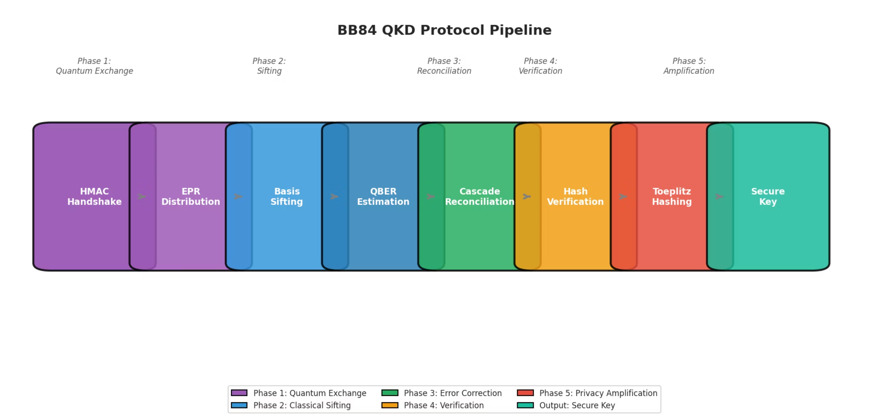
Extending Quantum Key Distribution (QKD)

Slide 2


Phase 1: Connection & Quantum Exchange
Secure Handshake
Alice and Bob use a pre-shared key for authentication, signing all classical messages to prevent tampering or impersonation.
Quantum Transmission (BB84)
Quantum hardware is engaged. Alice sends entangled photon pairs (qubits) to Bob. Both measure randomly in "Standard" (Z) or "Diagonal" (X) basis, resulting in roughly 50% correlated raw data.

Slide 3



Phase 2: Sifting & Estimation
Basis Sifting
Alice shares her measurement bases with Bob. They discard bits where bases differed, retaining only matching measurements.
Error Estimation
A small, random subset of matching bits is publicly compared to detect eavesdropping (QBER). If QBER is too high (>11%), the protocol aborts.

Slide 4


Phase 3: Reconciliation (Cascade)
Correcting errors in the shared key while minimizing information leakage.
Interactive Error Correction
Keys are divided into blocks. Alice sends parity of her blocks to Bob. Mismatches indicate errors.
Binary Search
Blocks are recursively cut in half to pinpoint and fix errors. Bob flips the incorrect bit.
Backtracking
Previous blocks are re-checked as fixing one error can reveal others. This continues until confidence in error-free keys is high.

Slide 5
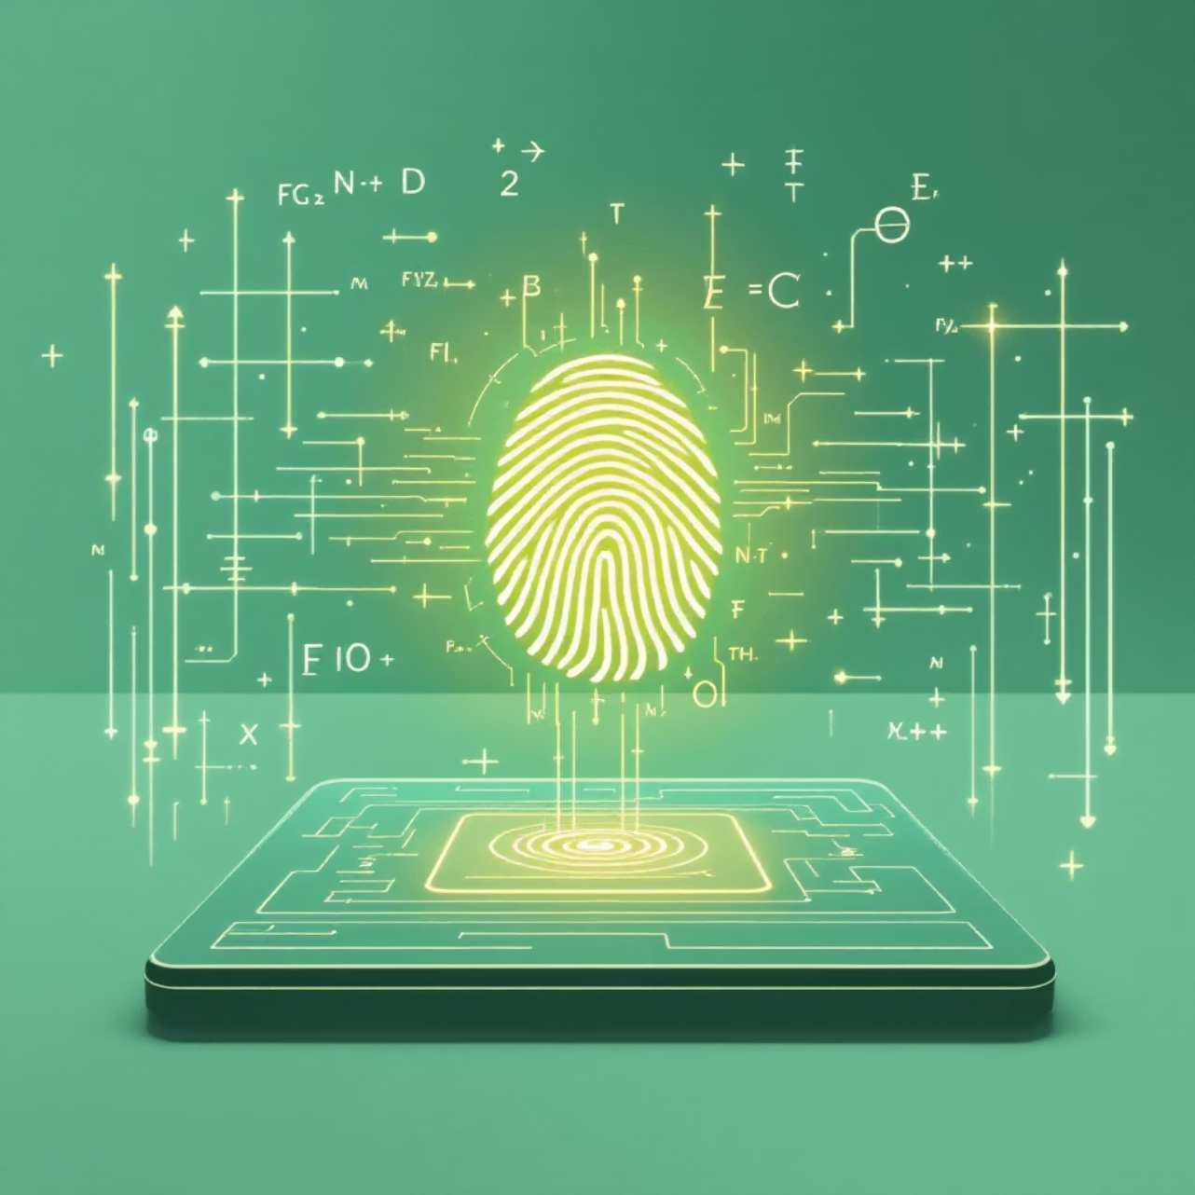
Phase 4: Verification
Polynomial Hashing
Alice generates a random "salt" and creates a unique fingerprint of her key using a mathematical formula. She sends the salt and fingerprint to Bob.
The Check
Bob performs the same calculation on his key. If his fingerprint matches Alice's, verification succeeds. Otherwise, the protocol aborts.

Slide 6

Phase 5: Privacy Amplification
Calculating Secrecy
Key Distillation (Toeplitz Hashing)
Alice and Bob quantify potential eavesdropper knowledge from both quantum and classical channels (QBER and parity bits).
They agree on a compression recipe. Alice sends a random "seed" to Bob, used to construct a Toeplitz Matrix.
Final Output
Keys are multiplied by the matrix, mixing bits and shrinking the key length. The result is a shorter, unconditionally secret key.

Slide 7
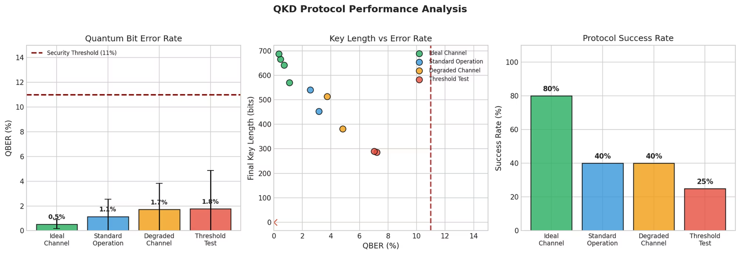
Experimental Results:

Slide 8
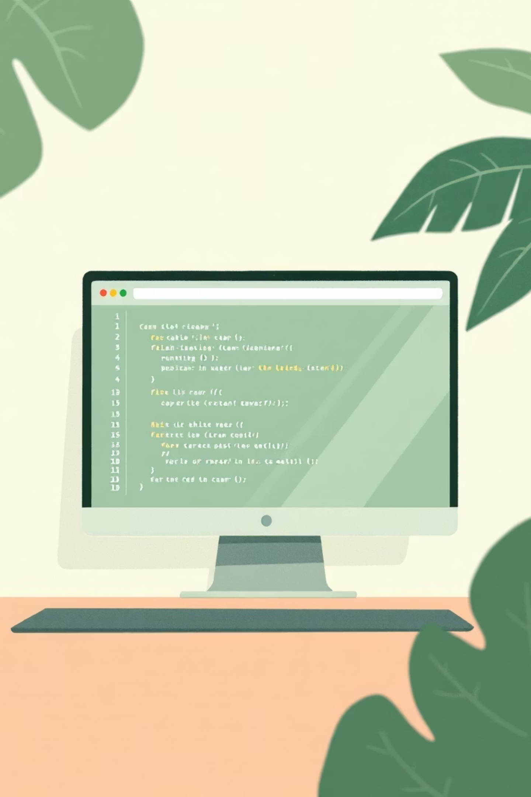
Live Demo

Slide 9



The Future of Secure Communication
QKD is paving the way for a new era of cybersecurity, ensuring data integrity and confidentiality in an increasingly quantum world.

